Slide 1
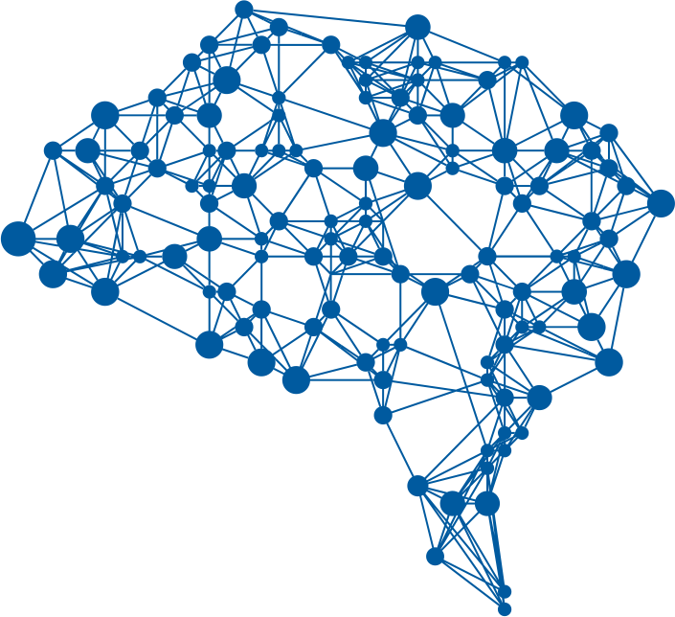
Neural Network Architectures
Putting everything together
Yordan Darakchiev
Technical Trainer
iordan93@gmail.com

Slide 2
sli.do
#DeepLearning

Slide 3
Table of Contents
Architectures: review
Transfer learning
Semi-supervised methods
Image captioning

Slide 4
Architectures
A recap on the popular ones

Slide 5
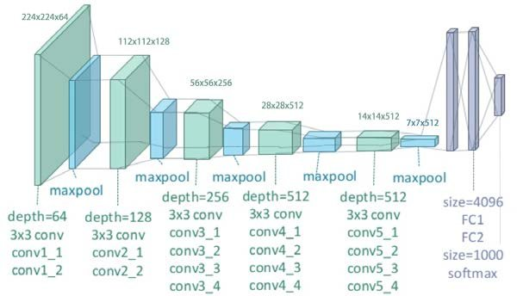

VGG-19
Input shape: $[n_{img}, 224,224,3]$
Output shape: $\left[n_{img}, 1000\right]$
Total params: 143 667 240
Input flow
  Read image
  Resize
  Preprocess
Predict
Decode predictions
from tensorflow.keras.applications.vgg19 import \
preprocess_input, VGG19, decode_predictions

Slide 6
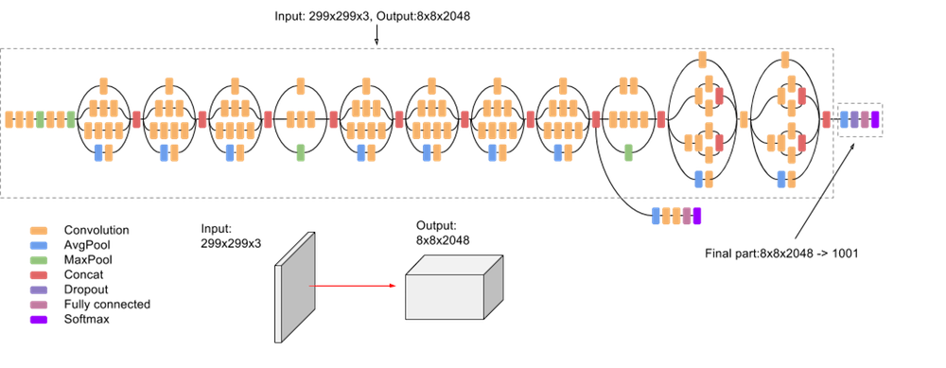

Inception v3
Input shape: $\left[n_{img}, ?,?,3\right]$
  Originally $?=299$
Output shape: $\left[n_{img}, 1000\right]$
Total params: 23 851 784
from tensorflow.keras.applications.inception_v3 import \ InceptionV3, decode_predictions, preprocess_input

Slide 7
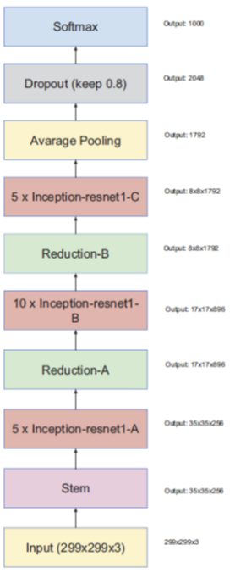

Inception-ResNet v2
Input shape: $\left[n_{img}, ?,?,3\right]$
  Originally $?=299$
  We don't need to resize the image,
  just apply preprocessing
Output shape: $\left[n_{img}, 1000\right]$
Total params: 55 873 736
from tensorflow.keras.applications. inception_resnet_v2 \
import preprocess_input, InceptionResNetV2, decode_predictions

Slide 8
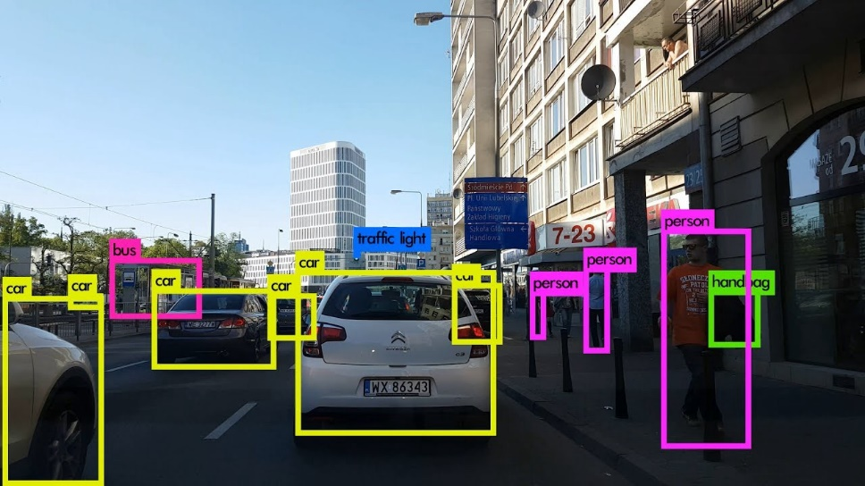
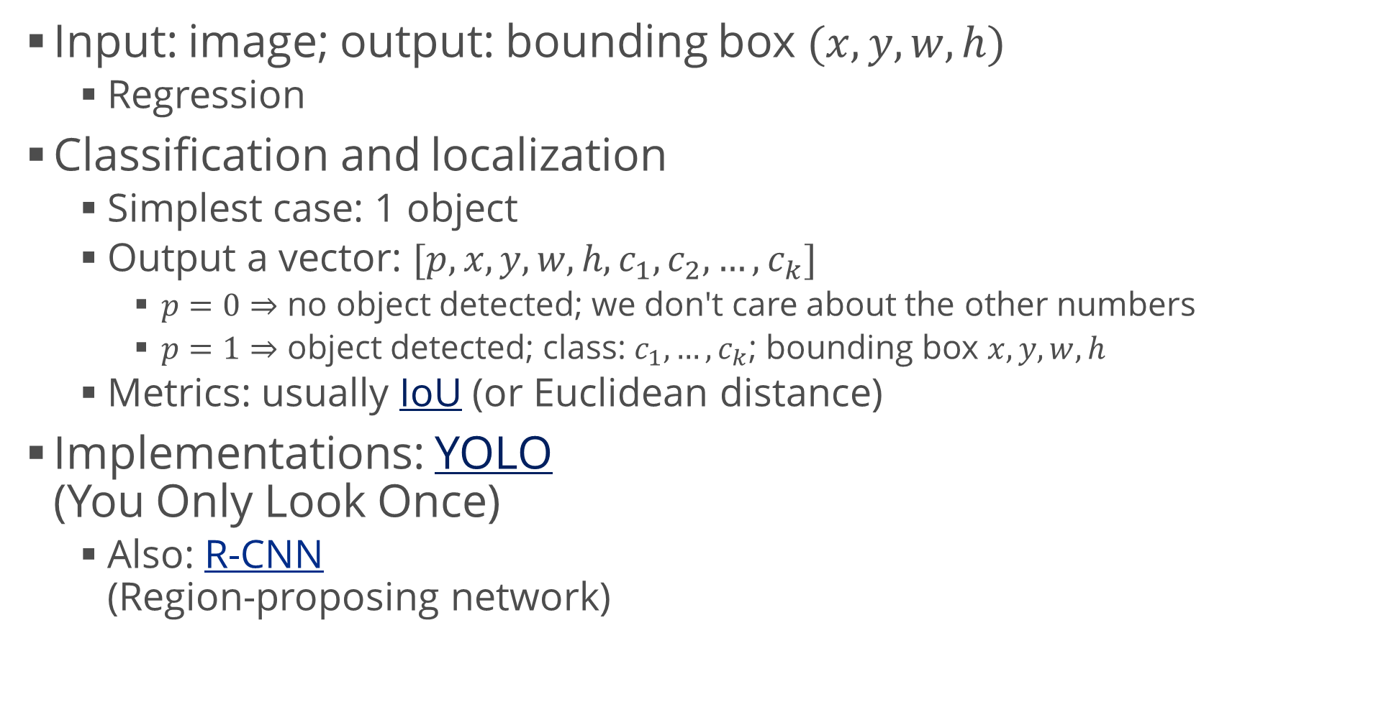
Object Localization
Input: image; output: bounding box $(x,y,w,h)$
  Regression
Classification and localization
  Simplest case: 1 object
  Output a vector: $[p, x, y, w, h, c_{1},c_{2},…,c_{k}]$
    $p=0⇒$ no object detected; we don't care about the other numbers
    $p=1⇒$ object detected; class: $c_{1},…,c_{k}$; bounding box $x,y,w,h$
  Metrics: usually IoU (or Euclidean distance)
Implementations: YOLO
(You Only Look Once)
  Also: R-CNN
  (Region-proposing network)

Slide 9
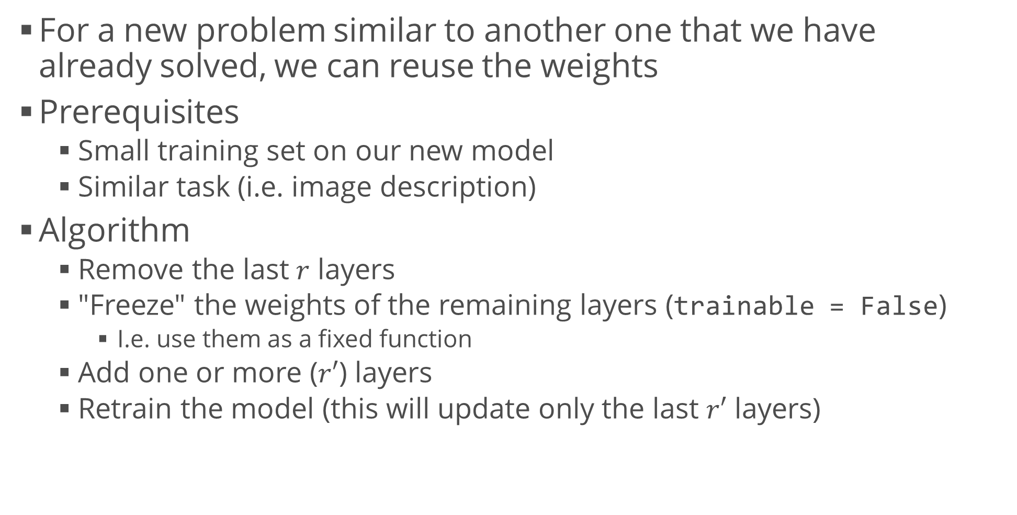
Transfer Learning
For a new problem similar to another one that we have
already solved, we can reuse the weights
Prerequisites
  Small training set on our new model
  Similar task (i.e. image description)
Algorithm
  Remove the last $r$ layers
  "Freeze" the weights of the remaining layers (trainable = False)
    I.e. use them as a fixed function
  Add one or more ($r′$) layers
  Retrain the model (this will update only the last $r′$ layers)

Slide 10
Semi-Supervised Methods
Venturing into unsupervised land

Slide 11
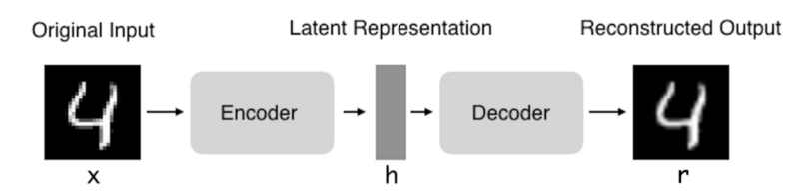
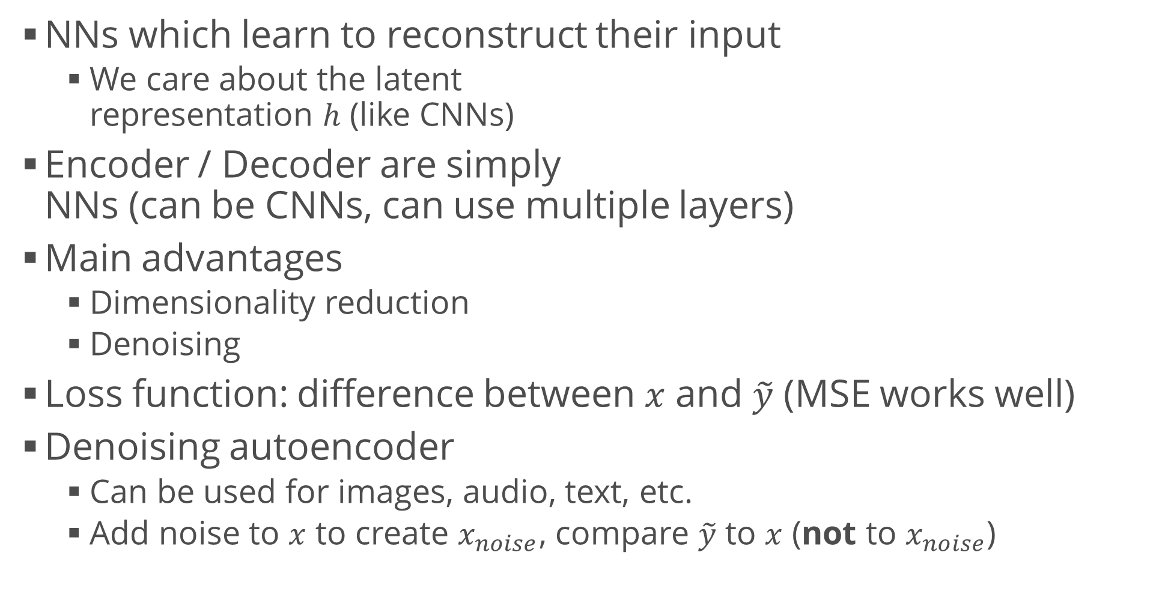
Autoencoders
NNs which learn to reconstruct their input
  We care about the latent
  representation $h$ (like CNNs)
Encoder / Decoder are simply
NNs (can be CNNs, can use multiple layers)
Main advantages
  Dimensionality reduction
  Denoising
Loss function: difference between $x$ and $\tilde{y}$ (MSE works well)
Denoising autoencoder
  Can be used for images, audio, text, etc.
  Add noise to $x$ to create $x_{noise}$, compare $\tilde{y}$ to $x$ (not to $x_{noise}$)

Slide 12
One-Shot Learning
Example: Facial recognition
  Input: image of a face; background data: allowed faces
  Output: Does the image match any of the allowed faces?
We aren't allowed to train on many pictures
  We usually have one picture per person
This concept generalizes to other multi-class
classification tasks
Solution: Siamese networks
  Two identical networks receive two images
  and compute two vectors
  The distance between the vectors is their (dis)similarity score
  Dimensionality reduction technique (also similar to clustering)

Slide 13
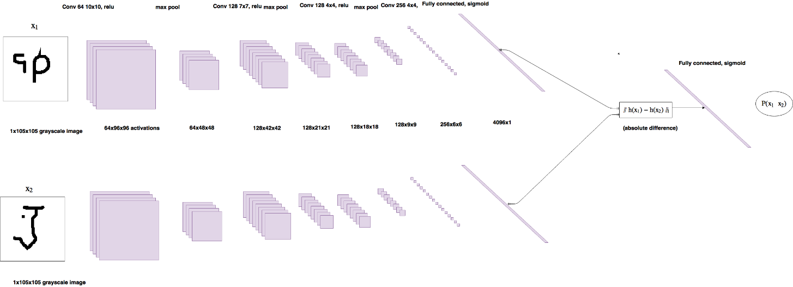

One-Shot Learning (2)
Training: triplet loss function
  Input images: anchor $a$, positive $p$, negative $n$
  Output: vectors $e_{a}, e_{p},e_{n}$
  Loss: low distance from $e_{a}$ to $e_{p}$, high distance from $e_{a}$ to $e_{n}$:
  $L\left(a,p,n\right)=\max\left(d\left(e_{a},e_{p}\right)−d\left(e_{a}, e_{n}\right)+m, 0\right)$
    $m$ – margin (similar to SVMs, allows us to distinguish better)

Slide 14
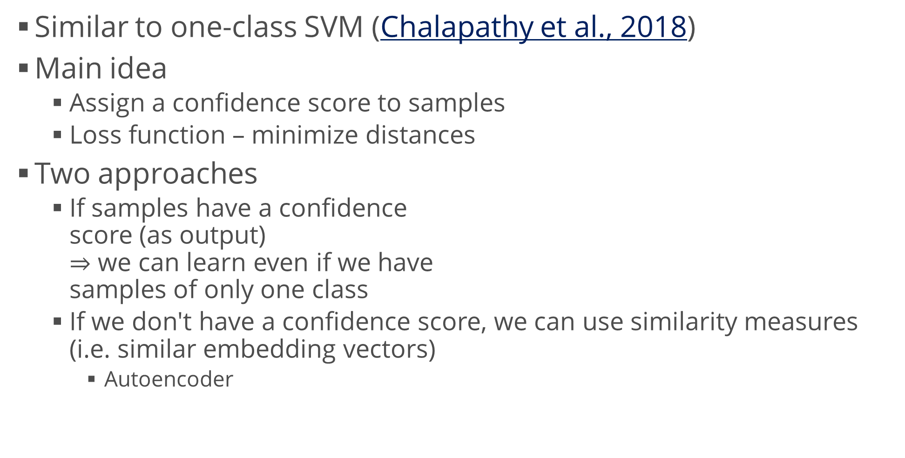
Novelty Detection
Similar to one-class SVM (Chalapathy et al., 2018)
Main idea
  Assign a confidence score to samples
  Loss function – minimize distances
Two approaches
  If samples have a confidence
  score (as output)
  $⇒$ we can learn even if we have
  samples of only one class
  If we don't have a confidence score, we can use similarity measures
  (i.e. similar embedding vectors)
    Autoencoder

Slide 15
Image Captioning
Describing images to humans

Slide 16
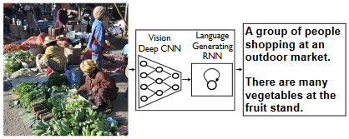
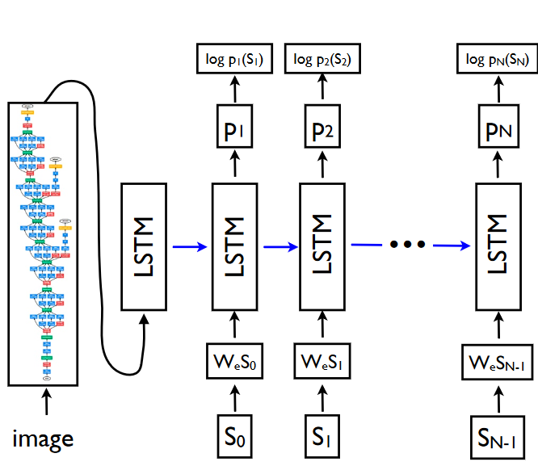
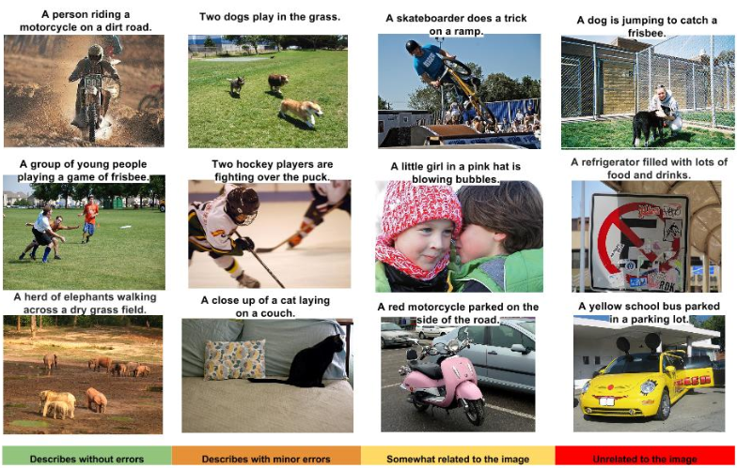
Image Captioning
Vinyals et al., 2015 (code)
Similar to machine translation
  Encoder: CNN instead of RNN
  Decoder: RNN (LSTM)

Slide 17
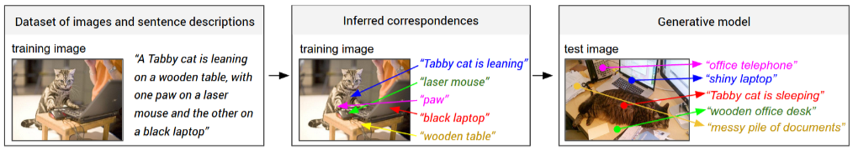
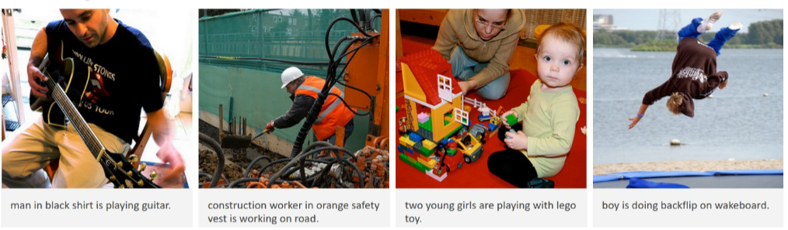
Image Captioning (2)
Extension: Karpathy and Li, 2015
  Goal: propose regions and describe them individually
  R-CNN to get regions
  Bi-directional RNN to generate sentences
Both embeddings use the same-dimensional space

Slide 18
Summary
Architectures: review
Transfer learning
Semi-supervised methods
Image captioning

